Slide 1
Security Management
CSC 504
LECTURE SERIES 4 new

Slide 2
Concerns for Security
The Internet has been used for criminal activities which lead to:
threats to the long-term viability of businesses:
damage to reputation,
loss of customer confidence,
stolen intellectual property.
Loss fund and efforts
Reasons:
personal gain, IT egoism: high computer literacy level, low cost of browsing, ease of web access, unstructured IT policies, no common database

Slide 3
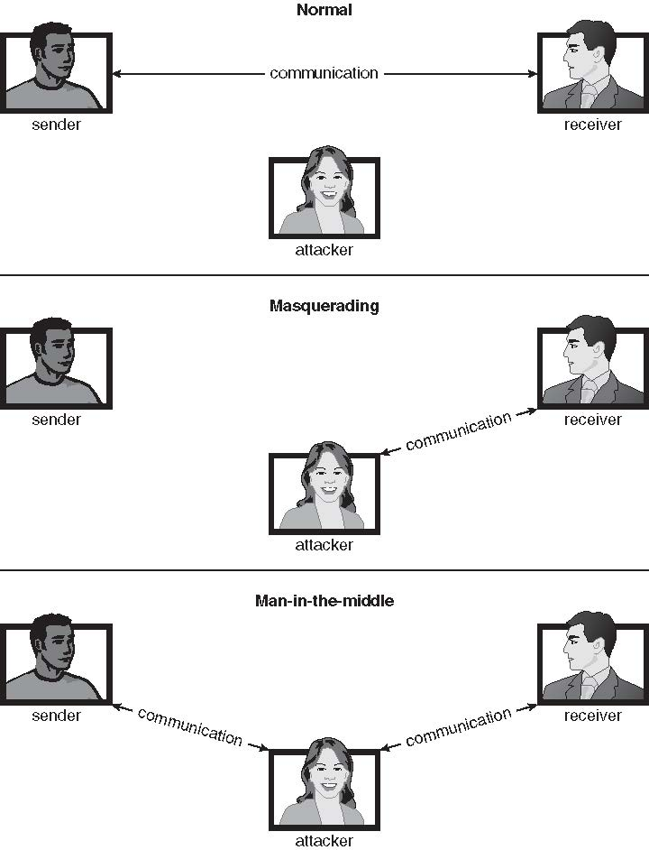
Middle man operations

Slide 4
Security Concerns…
Several questions can arise regarding network security:
What are the major Internet security problems and threats?
What technical aspects of protocols do criminals exploit?
What are the key aspects of security?
What technologies are available to help reduce security?
Why are threats peculiar to windows:
Most common
Everyone is an administrator
Require licensing i.e. permission rights as linux
Strong protection required

Slide 5
Security metrics
Quality yard sticks are: CIAA-Confidentiality, Integrity and Authenticity, Availability
Data Integrity. Integrity refers to protection from change: is the data that arrives at a receiver identical to the data that was sent?
Data Availability. Availability refers to protection against disruption of service: does data remain accessible for legitimate uses?
Data Confidentiality/privacy: Confidentiality refers to protection against unauthorized data access (encryption/encoding)
Authenticity: right sender and right receiver (password, tokens)
Non-repudiation of sender or Privacy. Privacy refers to the ability of a sender to remain anonymous: is the sender’s identity revealed?

Slide 6
Threats.attacks
Breach of confidentiality
Unauthorized reading of data
Breach of integrity
Unauthorized modification of data
Breach of availability
Unauthorized destruction of data
Theft of service
Unauthorized use of resources
Denial of service (DOS)
Denial of the legitimate user/ legitimate resources

Slide 7
…
Masquerading (breach authentication)
Pretending to be an authorized user to escalate privileges
Replay attack
As is or with message modification
Man-in-the-middle attack
Intruder sits in data flow, masquerading as sender to receiver and vice versa
Session hijacking
Intercept an already-established session to bypass authentication
Script kiddies can run pre-written exploit code to attack a given system
Attack code can get a shell with the process’s owner permissions
Or open a network port, delete files, download a program, etc.
Depending on bug, attack can be executed across a network using allowed connections, bypassing firewalls

Slide 8
Data, networks attacks are increasing geometrically – malwares, spams, spoofing etc
Attacks has moved with trends to tools of organized crime
Yahoo-yahoo as they call some methods
Targeting specific companies
Creating downloadable codes as tool for spam and DDOS delivery
Keystroke logger to grab passwords, credit card numbers

Slide 9
Intrusions: port scanning and DDOS
Port scanning
Automated attempt to connect to a range of ports on one or a range of IP addresses
Detection of answering service protocol
Detection of OS and version running on system
nmap scans all ports in a given IP range for a response
nessus has a database of protocols and bugs (and exploits) to apply against a system
Frequently launched from zombie systems
To decrease trace-ability

Slide 10
Intrusion
Denial of Service
Overload the targeted computer preventing it from doing any useful work
Distributed denial-of-service (DDOS) come from multiple sites at once
Consider the start of the IP-connection handshake (SYN)
How many started-connections can the OS handle?
Consider traffic to a web site
How can you tell the difference between being a target and being really popular?
Accidental – CS students writing bad fork() code
Purposeful – extortion, punishment

Slide 11
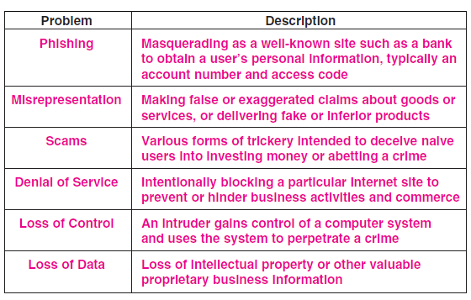
Types of threats

Slide 12
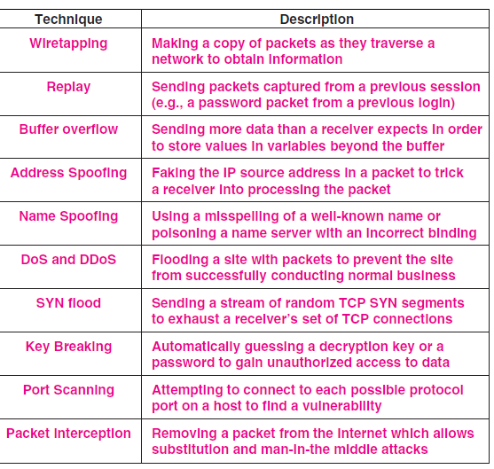
Threat types…

Slide 13
Issues on Security…
Accountability. Accountability refers to identifying who is responsible for what e.g. an audit trail can be kept for all activity that happen to data movement within the system, data mining tools can be used to phish out who uses what
Authorization. Authorization refers to what aspect of data is allowed to access and who is to access (I,e. defining of roles)
The critical issue underlying both accountability and authorization is access control
Authorization policies are meaningless without an authentication
mechanism that can unambiguously verify the identity of a requester

Slide 14
Security measures
Impossible to have absolute security, but make cost to perpetrator sufficiently high to deter most intruders
Security must occur at four levels to be effective:
Physical
Data centers, servers, connected terminals
Human
Avoid social engineering, phishing, dumpster diving
Operating System
Protection mechanisms, debugging
Network
Intercepted communications, interruption, DOS
Security is as weak as the weakest link in the chain
But can too much security be a problem?

Slide 15
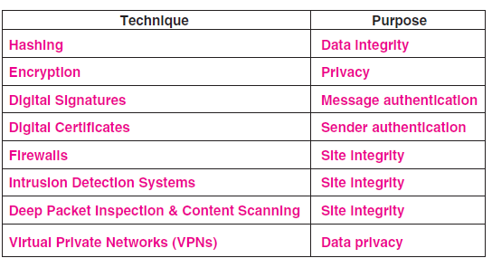
Security Mechanisms…

Slide 16
Nature of Problems
System is secured if resources are used and accessed as intended under all circumstances
No Unachievable
If not put security measures in place
Block Intruders (hackers) attempt to breach security
Prevent threat is a potential security violation
Attack is an attempt to breach security
Attack can be accidental or malicious
Easier to protect against accidental than malicious attacks

Slide 17
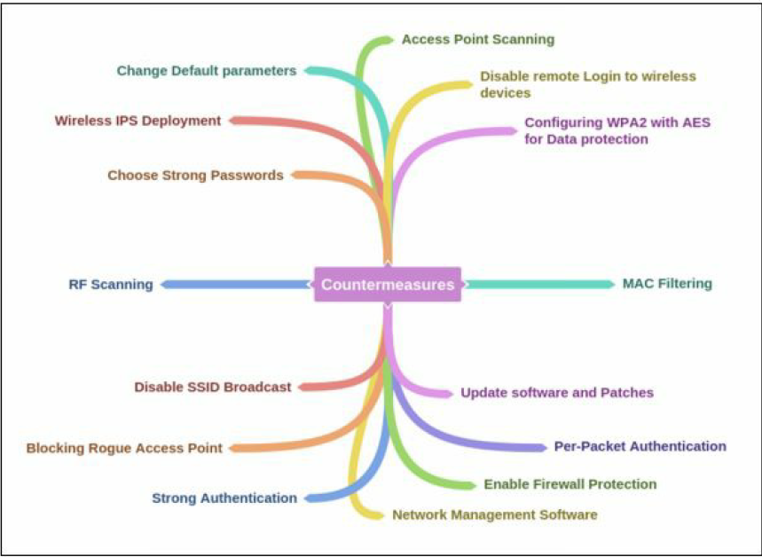
Security Countermeasures

Slide 18
Data Encryption
encryption can guarantee data confidentiality, authenticity, integrity,
In essence, a sender applies encryption to scramble the bits of a message in such a way that only the intended recipient can unscramble them.
Some terms are common:
Plaintext — an original message before it has been encrypted
Ciphertext — a message after it has been encrypted
Encryption key — a short bit string used to encrypt a message
Decryption key — a short bit string used to decrypt a message

Slide 19
Encryption…
Mathematically, we think of encryption as a function, encrypt, that takes two arguments:
a key, K1, and a plaintext message to be encrypted, M.
The function produces an encrypted version of the message, called cyphertext C:
C = encrypt (K1, M)
A decrypt function reverses the mapping to produce the original message:
M = decrypt (K2, C)
Mathematically, decrypt is the inverse of encrypt:
M = decrypt (K2 , encrypt (K1 , M))

Slide 20
Private Key Encryption (Symmetric)
In a private key system, each pair of communicating entities share a single key that serves as both an encryption key and a decryption key.
The name arises because the key must be kept secret — if a third party obtains a copy of the key, the third party will be able to decrypt messages passing between the pair.
Private key systems are symmetric in the sense that each side can send or receive messages.
To send a message, the key is used to produce ciphertext, which is then sent across a network.
When a message arrives, the receiving side uses the secret key to decode the ciphertext and extract the original (plaintext) message.
Thus, in a private key system, a sender and receiver each use the same key, K, which means that:
M = decrypt (K, encrypt (K, M) )

Slide 21
Public Key Encryption (Asymetric)
Public-key encryption based on each user having two keys:
public key – published key, used to encrypt data
private key – key known only to individual user, used to decrypt data
One of the user’s keys, called the private key, is kept secret, while the other, called the public key, is published along with the name of the user, so everyone knows the value of the key.
The encryption function has the mathematical property that a plaintext message encrypted with the public key cannot be decrypted except with the private key, and a plaintext message encrypted with the private key cannot be decrypted except with the public key.
The encryption functions can be expressed as:
M = decrypt ( public_u1 , encrypt ( private_u1, M) )
and
M = decrypt ( private_u1 , encrypt ( public_u1, M) )

Slide 22
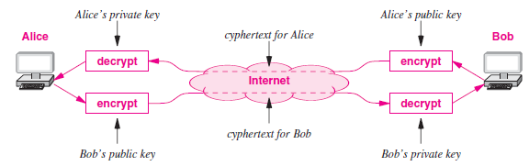
Use of both Public & Private Keys

Slide 23
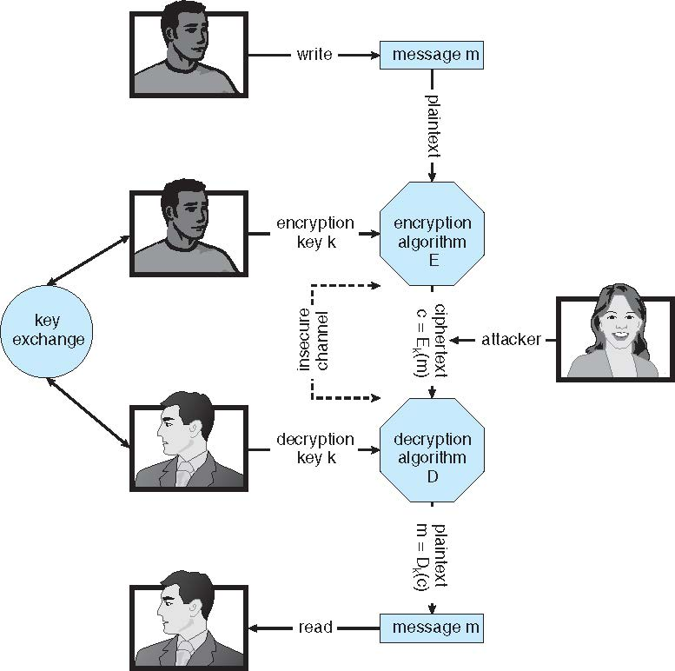
Symmetric encryption- key exchange important

Slide 24
Asymmetric Encryption
Public-key encryption based on each user having two keys:
public key – published key used to encrypt data
private key – key known only to individual user used to decrypt data
Must be an encryption scheme that can be made public without making it easy to figure out the decryption scheme
Most common is RSA block cipher
Efficient algorithm for testing whether or not a number is prime
No efficient algorithm is know for finding the prime factors of a number
Formally, it is computationally infeasible to derive k_{d,N} from k_{e,N}, and so k_{e} need not be kept secret and can be widely disseminated
k_{e} is the public key
k_{d} is the private key
N is the product of two large, randomly chosen prime numbers p and q (for example, p and q are 512 bits each)
Encryption algorithm is E_{ke,N}(m) = m^{ke} mod N, where k_{e} satisfies k_{e}k_{d} mod (p−1)(q −1) = 1
The decryption algorithm is then D_{kd,N}(c) = c^{kd} mod N

Slide 25
RSA Algorithm
Makes use of modulo-n arithmetic
Uses a choice of public key & private key
Steps:
1 choose 2 prime numbers: p q., the larger the value the more difficult to break
2. compute n=pq and z=(p-1)(q-1)
3. choose a number, e, less than n, that has no common factors other than 1 with z
4. find a number , d, such that e*d-1 is exactly divisible by z i.e. ed mod z = 1
5. the encrypted text is c= m^{e} mod n
And decrypted value is m= c^{d} mod n
E.g. p=5 q=7, with this n=35 z=24, e=5, d=29

Slide 26
Asymmetric example
Make p = 7 and q = 13
We then calculate N = 7∗13 = 91 and (p−1)(q−1) = 72
We next select k_{e} relatively prime to 72 and< 72, yielding 5
Finally, we calculate k_{d} such that k_{e}k_{d} mod 72 = 1, yielding 29
We how have our keys
Public key, k_{e,N} = 5, 91
Private key, k_{d,N} = 29, 91
Encrypting the message 69 with the public key results in the cyphertext 62
Cyphertext can be decoded with the private key
Public key can be distributed in cleartext to anyone who wants to communicate with holder of public key

Slide 27
To encrypt Love using RSA => QOVJ

Slide 28
To decrypt QOVJ to LOVE

Slide 29
Hashing Mechanism
hashing scheme relies on a secret key known only to the sender and receiver.
The sender takes a message as input, uses the key to compute a hash, H, and transmits H along with the message.
H is a short string of bits, and the length of H is independent of the message size.
The receiver uses the key to compute a hash of the message, and compares the hash to H.
If the two agree, the message has arrived intact.
An attacker, who does not have the secret key, will be unable to modify the message without introducing an error.

Slide 30
Assignment
Group A: Describe the use of Steganography and Advanced Encryption Standard (AES)
Group B: Compare information hiding and anonymity approaches to counter hacker
Group C: Explain how a firewall works on Windows operating stystem
Group D: Windows 10 has windows defender, describe its usefulnesses

